Slide 1
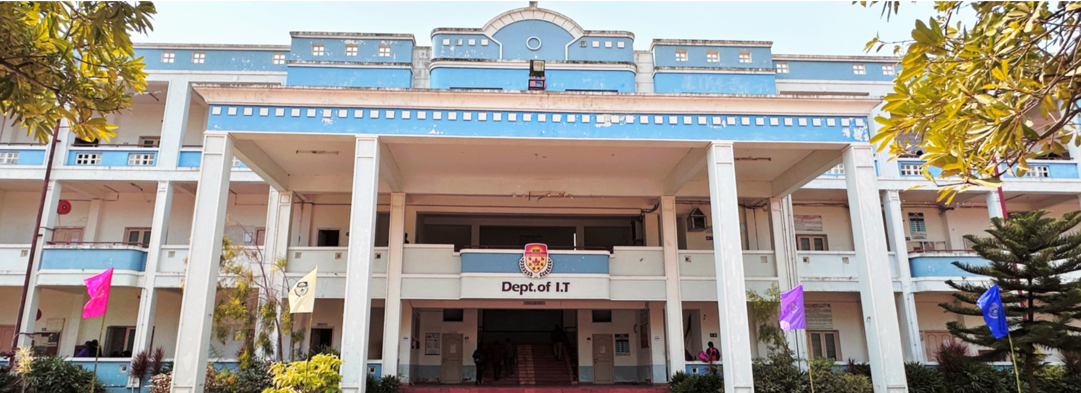
International Conference on Innovation Intelligent and Smart Technologies (ICIIST 2024)
20th & 21st September 2024
Organized by
Department of Information Technology, Aditya Institute of Technology and Management
URL: https://iciist.aitamitdept.org.in
Call for Papers / Participation
CHIEF PATRONS
Dr. K. Someswara Rao, Chairman
PATRON
Sri L. L. Naidu, Secretary
Sri T. Naga Raju, Treasurer Prof.V.V.Nageswara Rao,Director
Mrs. V. Sudha Priya,Vice Chairman
Dr. K. Ravi Kumar Joint Secretary
Sri K. Madhu Kumar, Director
Sri T. Naga Seshu, Director Sri. V Naga Sanketh, Director
CONFERENCE CHAIR
Dr. A.S. Srinivasa Rao, Principal
PROGRAM CHAIR
Dr. Ch Ramesh, DEAN
Dr. B V Ramana DEAN
CONVENER
Dr. Y Ramesh, HOD IT
CO - CONVENER
Dr. U.D. Prasan, HOD CSE
Dr. B. Rama Rao, HOD ECE
Dr. M.V.B.Chandra Sekhar, HOD CSM&CSD
EDITORIAL BOARD
Dr. Y.Ramesh, HOD IT, AITAM
Dr. K.Srujan Raju, Professor, Dean & HOD CSE, CMR Technical Campus
Dr. Lvascu, Director of Research Center in Engineering and Management, Timisoara, Romania
Dr. Kuan Tak Tan, Associate Professor EEE, Singapore Institute of Technology, Singapore.
The International Conference on Innovation Intelligent and Smart Systems (ICIIST) will provide a large platform for academics, researchers, students, and industry engineers to exchange thoughts and expertise about four tracks Intelligent Systems, Networking and Cyber Security, Smart Systems and Electronics. The bottom line of the conference is to appreciates articles which mainly highlight recent trends, challenges, opportunities in order to shed new light on potential avenues for change and to better the lives of ordinary citizens.
Bring together the international level professionals to share fresh research discoveries in Intelligent Systems, Networking and Cyber Security, Smart Systems and Electronics, expand our understanding of cutting-edge technology, and foster international scientific and community collaborations while collaborating with other professional groups.
Have a technical talk in addition to the assigned reading.
INTERNATIONAL ADVISORY BOARD
Dr. Mohammed Hammad, Professor, Menoufla University, Egypt
Dr. Pawel Plawiak, Professor & Dean,
Cracow University of Technology.
Dr. Hikmet Hakan Gruel, Professor, Kocaeli University, Turkey.
Dr. Ch.Suresh Babu, Professor, King Khalid University, Saudi Arabia.
Dr. Firoz Ahmed, Professor, University of Rajshahi, Bangladesh
Dr. Shaui Li, Professor, University of Oulu, Finland.
NATIONAL ADVISORY BOARD
Dr. Vijaya Sarathi, IIT Guwahati
Dr. Dipendu Sinha Roy, NIT Meghalaya
Dr. R. Rajeswara Rao, JNTUGV, AP
Dr. K. Sahadevaiah, JNTUK, AP
Dr. P.Rajesh Kumar, Andhra University
Dr. Bala Chakravarthi N, NIT Rourkela
Dr. R. Malamathanraj, NIT Tiruchirapali
Dr. Madhusudhan Mishra, NERIST, Arunachal Pradesh
Dr. Narasimha Sarma N V S, NIT Warangal
Dr. B. Eswara Reddy, JNTU Anantapur, Andhra Pradesh
Dr. Naresh Babu M, IITDM Kurnool
Dr. Ramanujam E, NIT Silchar, Assam
Dr. Chandan Chakraborthy, NITTTR, Kolkata
Dr. Gangadhara Rao Kancharla, Acharya Nagarjuna University
Dr. Maitreyee Dutta, NITTTR, Chandigarh
Dr. T. Rama Krishnudu, NIT Warangal
Dr. M.Srinivas, NIT Warangal
Dr. C.Nagaraju, Yogi Vemana University
Dr. Santhosh Kumar Majhi, VSSUT Burla
Dr. Niraj Bala, NITTTR, Chandigarh
Dr. Hanumanthappa M, Bangalore University
Dr. S. Viswanadha Raju, JNTUH college of Engineering, Telangana
Dr. V. Kiran Kumar, Dravadian University, AP
Dr. K. Nageswara Rao, AU College of Engineering, Andhra University
Dr. S. Ramakrishna, Sri Venkateswara University, AP
Dr. O. Nagaraju, Acharya Nagarjuna University, AP
Dr. G. Sreedhar, National Sanskrit University, AP
& more……….
ICIIST -2024 invites papers of research on the following tracks:
Artificial Intelligence
Pattern & Speech Recognition
Fuzzy Logic & Soft Computing
Neural Networks
Cyber Security
Machine Learning
Cloud Computing
Adhoc and Sensor Networks
Smart Computing
Data Science
Wireless Communications
Digital Signal Processing
VLSI, Embedded Systems
5G and GPS Systems
Other topics related to
ICIIST Theme
TECHNICAL REVIEW COMMITTEE
Dr. G.Nageswara Rao, Professor, IT
Dr. B.Ramesh Naidu, Professor, IT
Dr. K. Kavita, Assistant Professor, IT
Dr. T. Naresh, Associate Professor, IT
Dr. H. Swapna Rekha, Assoc Prof, IT
Dr. T.P.R.Vithal, Professor, CSE
Dr. S. Vishnu Murthy, Assoc Prof, CSE
Dr. K. Eswara Rao, Assoc Prof, CSE
Dr. T. Ravi Kumar, Assoc Prof, CSE
Dr. M. Jayanthi Rao, Assoc Prof, CSE
Dr. G. Satheesh Kumar, Professor, ECE
Dr. V. Ashok Kumar, Professor, ECE
Dr. M.V.H. Bhaskara Murthy, Prof, ECE
Dr. K.V.L. Bhavani, Assoc Prof, ECE
Dr. N.V.S.S.Kumar, Assoc Prof, ECE
Dr. P.V. Muralidhar, Assoc Prof, ECE
Dr. S.V.S. Shanti, Assoc Prof, CSM&CSD
Dr. G. Stalin Babu, Assoc Prof, CSM&CSD
& more ……..
URL: https://iciist.aitamitdept.org.in
Address for communication
Convener , ICIIST 2024
Dept of IT, Aditya Institute of Technology and Management, Tekkali - 532201
Srikakulam, Andhra Pradesh
Contact Email: contact@iciist.aitamitdept.org.in
Contact Persons
Dr. Y. Ramesh : 9849765747
D. Reventh Raj : 9493939405
Call for Papers:
Paper submission Email https://cmt3.research.microsoft.com/ICIIST2024/Submission/index
Paper submission last date 31st May 2024
Acceptance Notification 29th June 2024
Registration 26th August 2024 (On or before)
Conference 20th – 21st September 2024

